Slide 1
Input- Output Devices
Hardware | Software | Firmware | Humanware

Slide 2
Characteristics of System
S.No. | Characteristic | Description
1. | Speed | Performs millions of operations in seconds; very fast processing.
2. | Accuracy | Produces highly accurate results if input is correct.
3. | Automation | Can run tasks automatically once instructions are given.
4. | Storage | Stores large amounts of data and retrieves it quickly.
5. | Versatility | Can be used for various tasks like typing, coding, editing, etc.
6. | Multitasking | Can handle multiple tasks at the same time.
7. | Diligence | Never gets tired or bored; can work continuously.
8. | Communication | Can communicate with other systems via networks.
9. | No IQ | Cannot think or make decisions; needs clear instructions.
10. | Language Understanding | Understands binary; users interact through high-level languages or GUI.

Slide 3
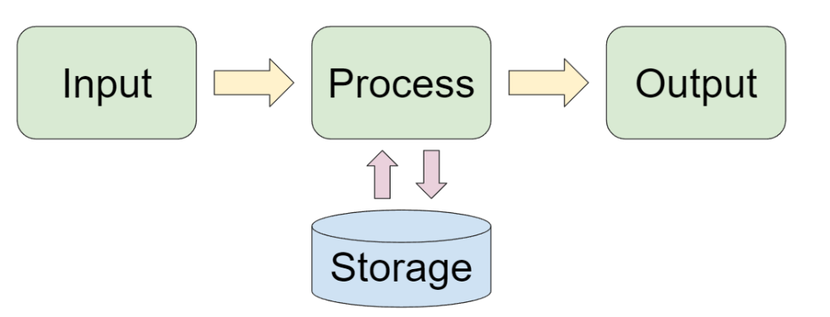
INPUT- OUTPUT DEVICES
Device Type | Example | Use/Function
Input | Keyboard | Typing text and commands
 | Mouse | Navigating and selecting items
 | Scanner | Converting physical documents into digital
 | Microphone | Inputting audio or voice commands
Output | Monitor | Displaying visual output like text/images
 | Printer | Producing hard copies of documents
 | Speakers | Outputting sound or music
 | Projector | Enlarging and displaying screen content
Definition
Input devices allow users to enter data or commands into a computer system.
Output devices allow the computer to communicate the results of processing back to the user.
Why Are They Important?
Enable communication between humans and machines
Input devices bring data into the system
Output devices let users receive information

Slide 4
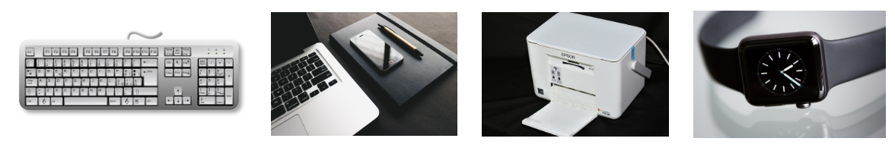
What is Hardware?
“Hardware refers to the physical parts of a computer system — things we can touch and see. Like our body has organs, a computer has hardware components.”
Input Devices
“Input devices are used to send data into the system for processing. Here are some common ones:
Keyboard – To input text
Mouse – To point and click
Scanner – To convert paper documents to digital
Microphone – To input sound
Webcam – To input visuals
Even touchscreens, barcode readers, and joysticks are input devices.”
Output Devices
“Output devices display or deliver the result of processed data. Some examples:
Monitor/Screen – To display text, images, videos
Printer – To get a hard copy
Speakers – To hear sound
Projector – To show visuals on a large screen
Some devices like a USB drive or Touchscreen serve as both input and output — they are called I/O devices.”

Slide 5
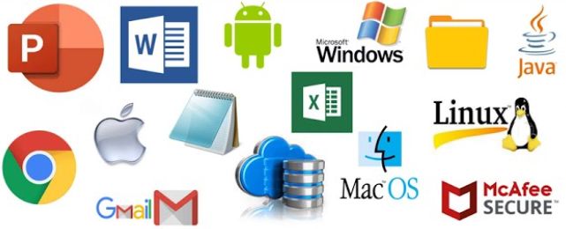
What is Software?
“While hardware is the body, software is the brain that tells the hardware what to do. Software is a set of instructions or programs that run on hardware.”
Types of Software:
System Software – Controls basic functions of the system
Operating Systems like Windows, Linux, macOS
Drivers to run hardware like printers or USBs
Utilities like antivirus or disk cleanup
Application Software – Helps us perform specific tasks
MS Word, PowerPoint, Excel, Zoom, Photoshop, Chrome

Slide 6
1. System Software
System software is a type of software that manages, operates, and controls the internal functioning of the computer hardware.
It acts as a bridge between the user, the application software, and the hardware.
Without system software, your computer wouldn’t start or be able to run any programs.
Includes:
Operating Systems Examples: Windows, Linux, macOS Function: Manages hardware & runs other software
Device Drivers Examples: Printer drivers, USB drivers Function: Enables communication between OS and hardware
Utilities Examples: Antivirus, Disk Cleanup Function: Maintains system performance and security
2. Application Software
Application software is designed to help users perform specific tasks such as writing documents, creating presentations, editing photos, or browsing the internet.
These programs run on top of the system software and allow users to interact directly with the computer to accomplish daily tasks.
Examples:
MS Word – Document editing
PowerPoint – Presentations
Excel – Spreadsheets and data analysis
Zoom – Video conferencing
Photoshop – Image editing
Chrome – Web browsing

Slide 7
Input-Output Softwares
Category | Examples
Input Software | Speech recognition software OCR (Optical Character Recognition) Keylogger (malicious input software) Form entry applications
Output Software | Display drivers Audio/video players Report generators Graphing/charting software PDF viewers
Input/Output Software | Video conferencing software (Zoom, Teams) Remote desktop applications Simulation software Data analytics tools with both input (data) and output (visualization)

Slide 8
Firmware
It is a special type of software that is permanently embedded into a hardware device. It provides low-level control for the device’s specific hardware and is essential for its basic functioning.
Key Features of Firmware
Stored in non-volatile memory (ROM, EEPROM, or Flash)
Cannot be easily changed by the user
Acts as a bridge between hardware and higher-level software
Runs before the operating system starts (e.g., BIOS)
🔹 Difference from Software
Software can be installed/removed/updated easily
Firmware is tightly bound to the hardware and is rarely changed
Examples of Firmware
Category | Examples
Input Firmware | Firmware in keyboards or mice (e.g., scan rate control) Scanner firmware
Output Firmware | Printer firmware (controls print head movement) Monitor firmware (controls brightness, contrast)
Input/Output Firmware | BIOS/UEFI (handles input from keyboard, outputs to monitor during boot) Embedded firmware in IoT devices or game controllers

Slide 9
Humanware
It refers to the people who design, develop, operate, and use computer systems. They are the most crucial component of any IT system because no system works without human interaction.
Why is Humanware Important?
Humans interact with hardware and software to complete tasks
They create, maintain, and improve the technology
They make decisions based on system output and feedback
Computers are powerful, but useless without human guidance, input, and creativity.
Role | What They Do
User | Uses the system for personal or professional work
Developer | Writes software and applications
System Administrator | Maintains servers, networks, and security
Technician | Installs and repairs hardware and systems
IT Support Staff | Helps users solve technical problems

Slide 10
Input-Output Humanware:
Category | Examples
Input (Humanware) | User entering data via keyboard/mouse Developer writing code Operator scanning barcodes
Output (Humanware) | User reading screen output Listening to audio output Observing printed reports
Input/Output (Humanware) | Teachers using educational software Doctors using diagnostic tools Engineers controlling CNC machines via software

